Slide 1
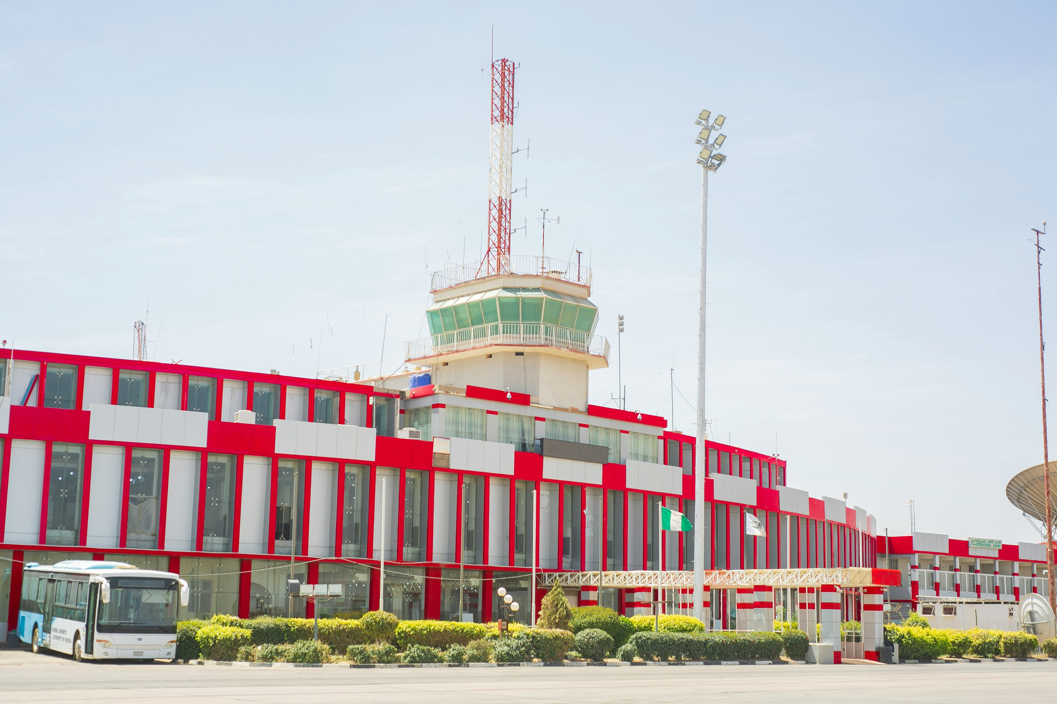
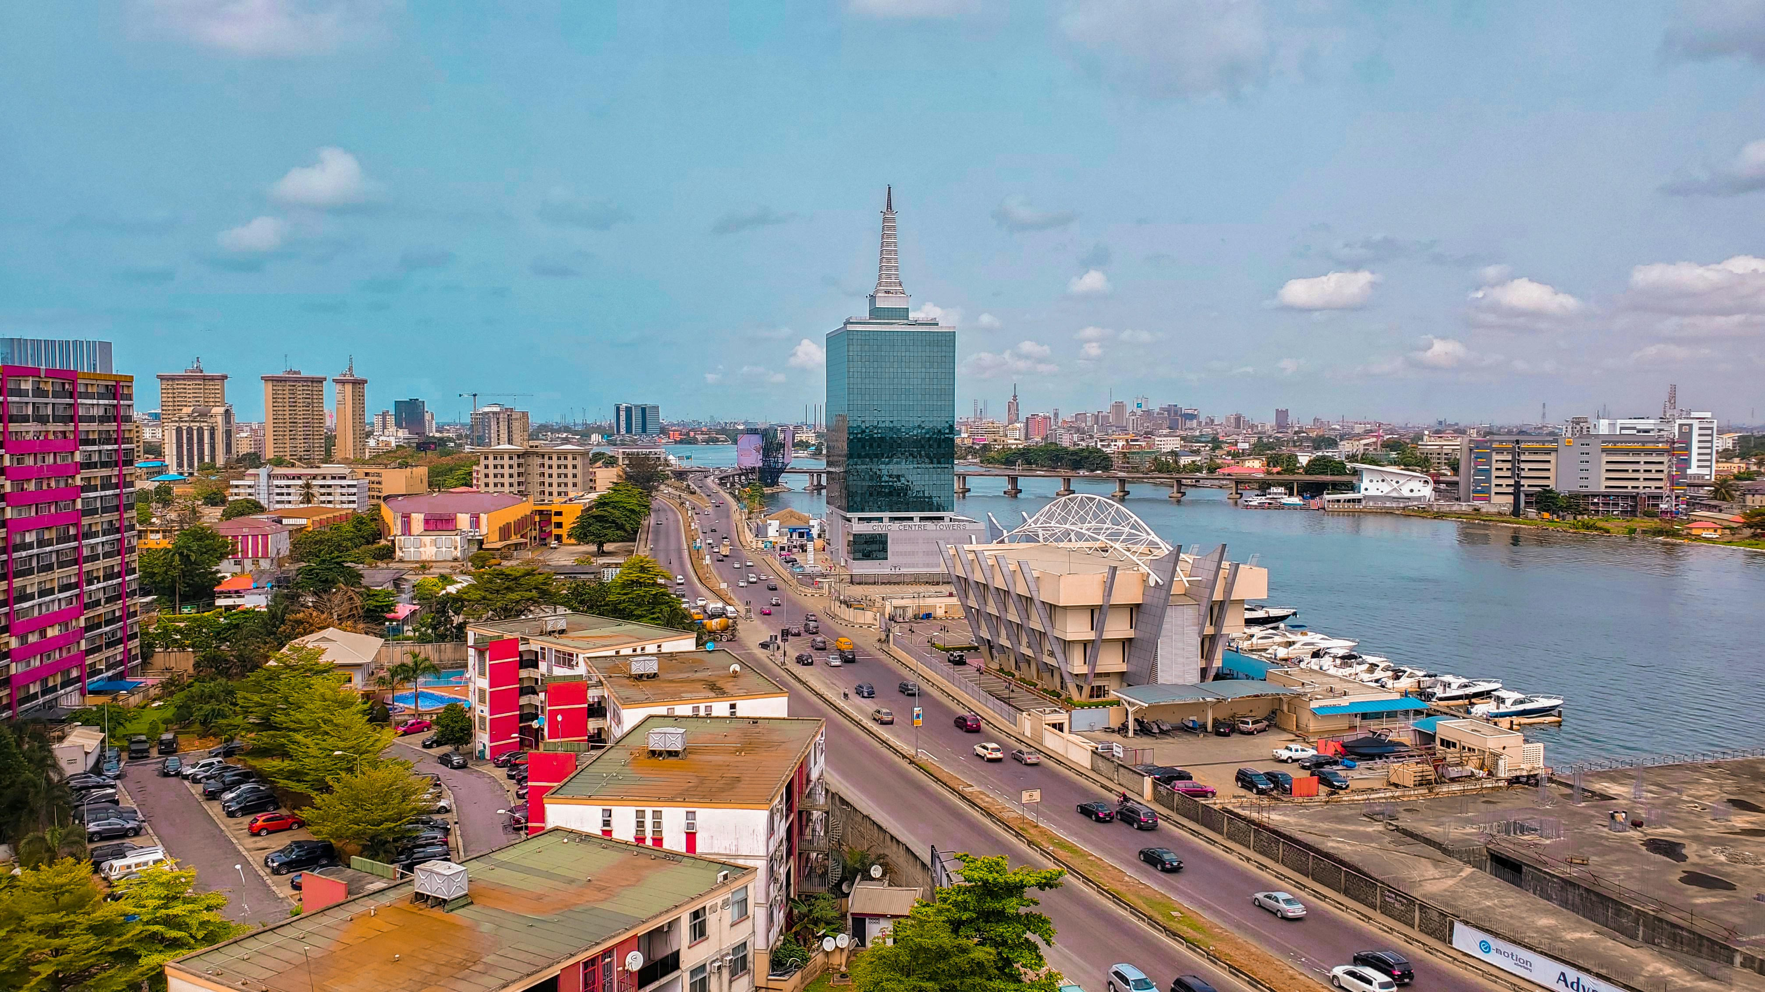
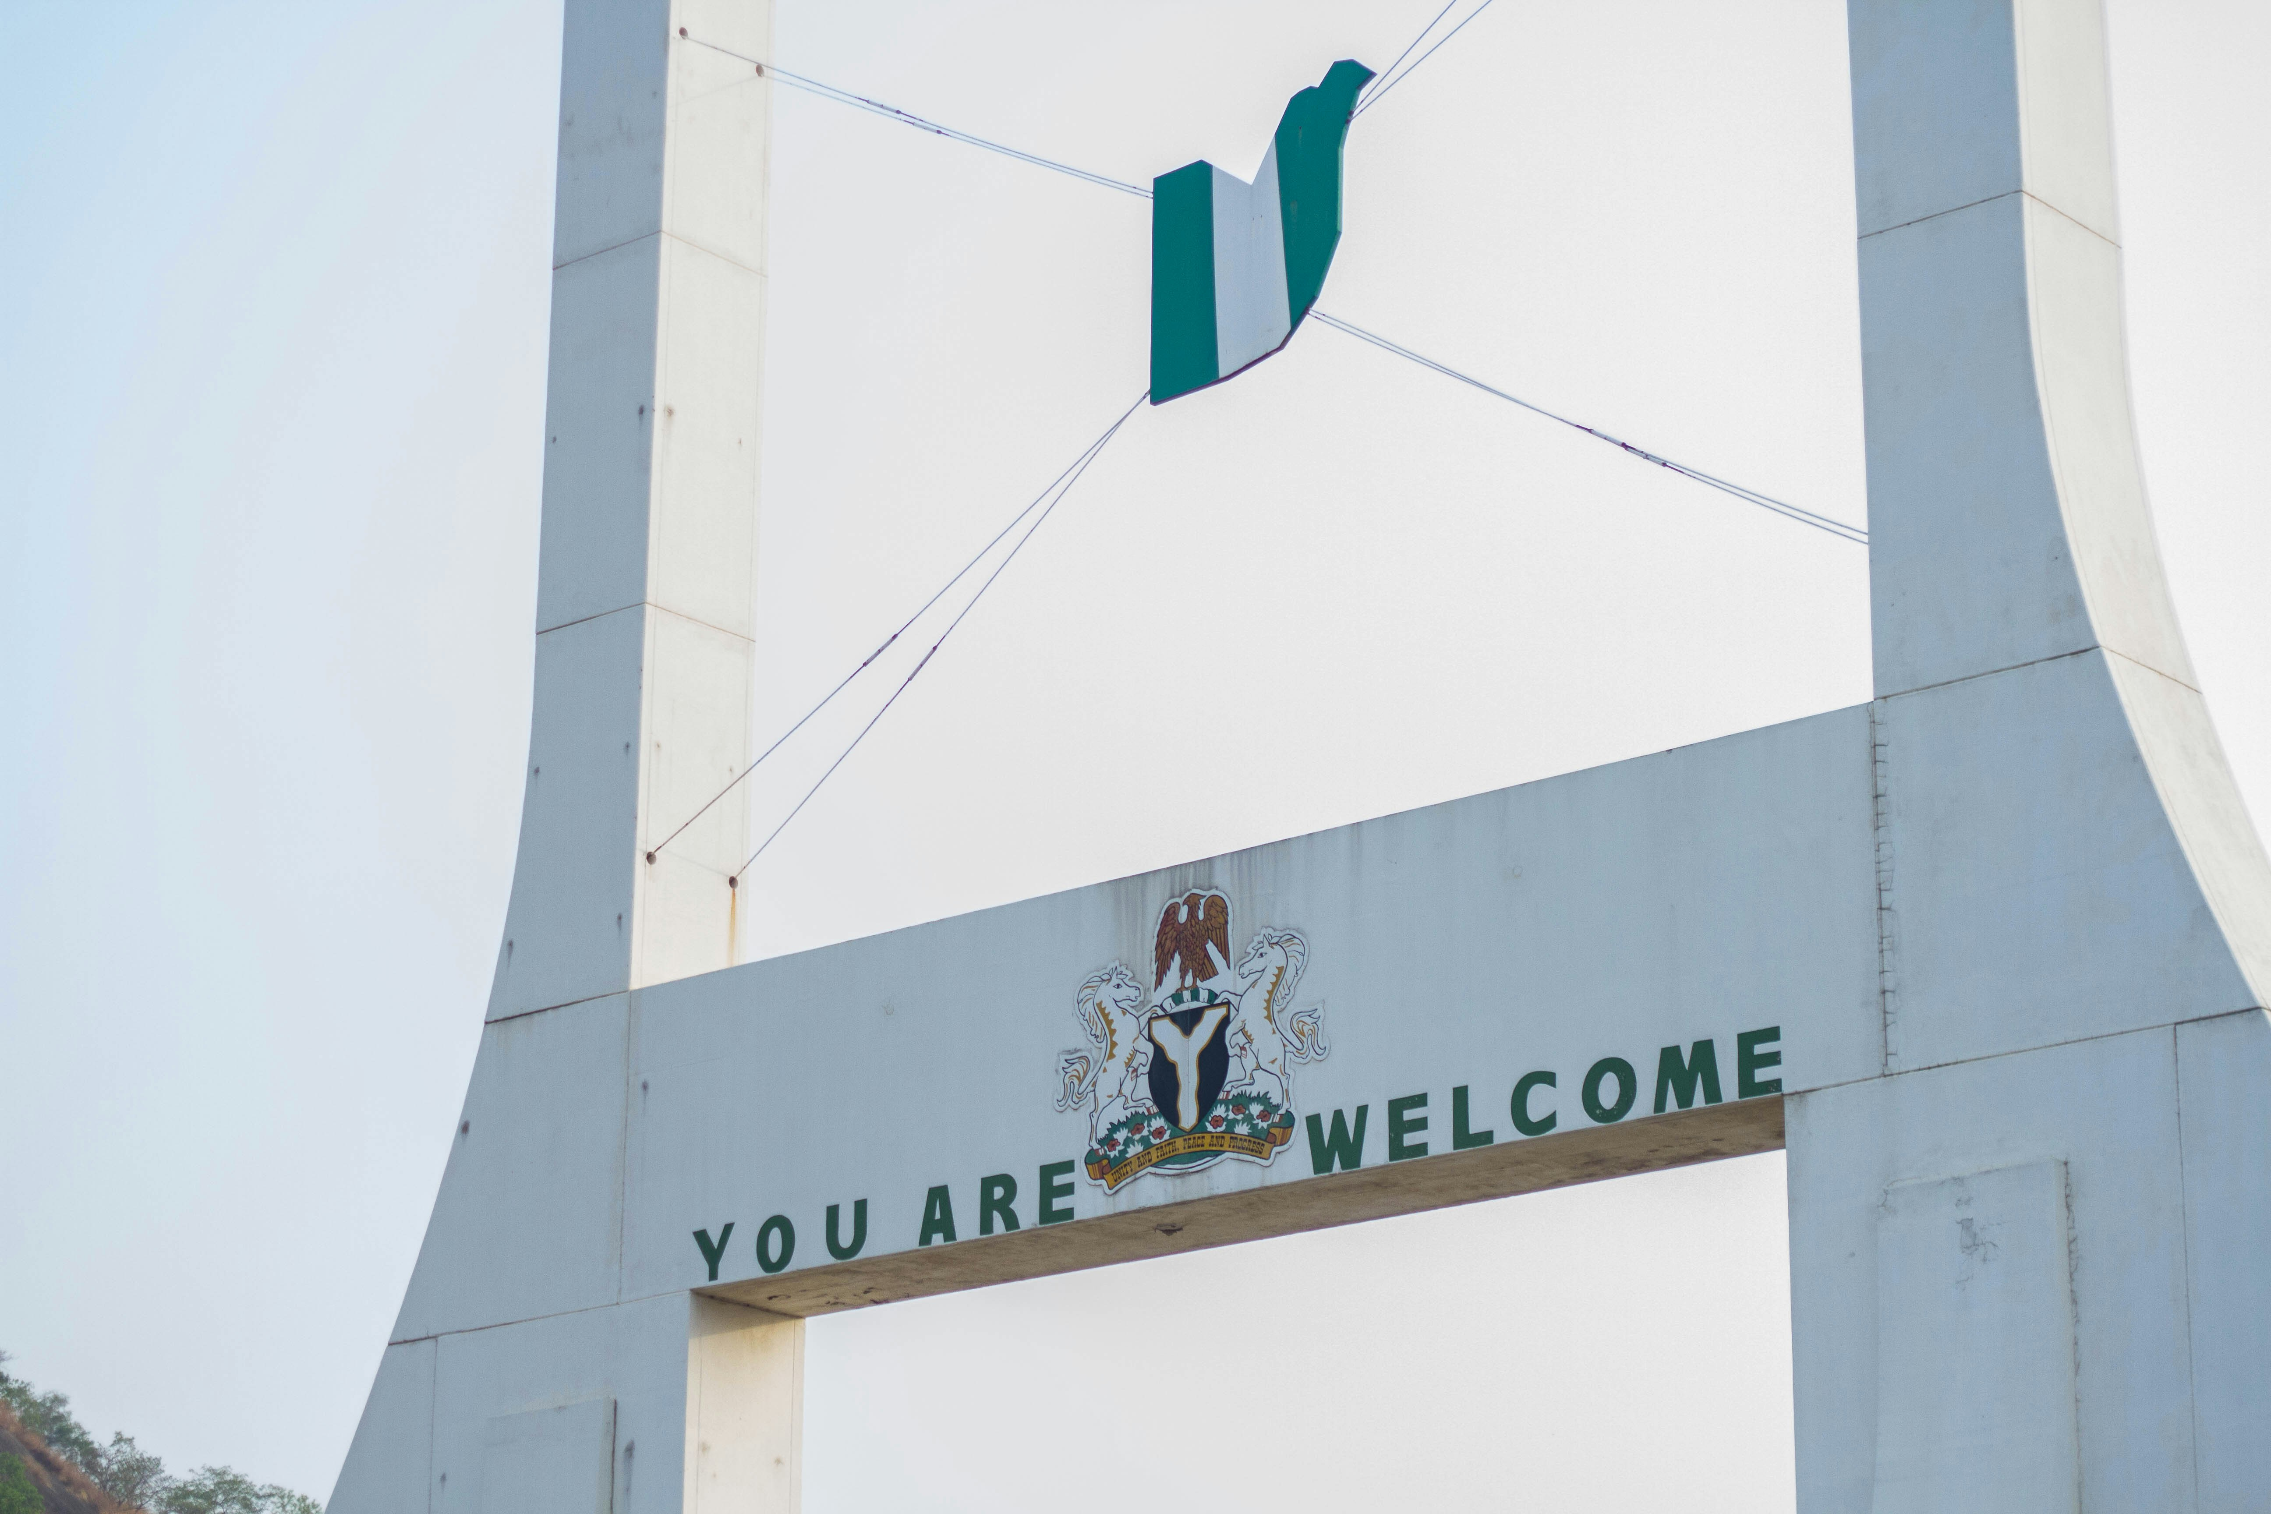
My favorite place in Nigeria
BY
UMAR ADEKOLA

Slide 2
Abuja, Nigeria
In every corner of Abuja, from its bustling markets to its serene parks, you can feel the pulse of a city that is constantly evolving and striving for greatness. It is a city that embraces its past while looking forward to a bright future.
Abuja, with its blend of natural beauty, cultural richness, and innovative spirit, stands as a testament to the best of Nigeria and the boundless potential of its people. And so, the story of Abuja continues, a story of a city that truly embodies the spirit of its nation – vibrant, resilient, and full of promise.

Slide 3
Lagos, Nigeria
Natural beauty is not absent from Lagos. The city boasts beautiful beaches like Tarkwa Bay and Elegushi, offering residents and visitors a respite from the urban hustle. Lekki Conservation Centre, with its canopy walk and rich biodiversity, provides a green oasis in the midst of the city.
In essence, Lagos is a city of contrasts and endless possibilities. It is a place where tradition meets innovation, where every street tells a story, and where dreams are pursued with relentless energy. The city's vibrancy, diversity, and resilience make it a microcosm of Nigeria itself – a nation on the move, brimming with potential and poised for greatness.

Slide 4
Kano, Nigeria
Kano is renowned for its distinctive architecture, characterized by traditional Hausa buildings made from mud bricks. The ancient city walls, known as the Ganuwa, are one of Kano's most iconic landmarks. Built in the 14th century, these walls once encircled the entire city, serving as a defense mechanism and a symbol of its strength. Though much of the walls have been eroded by time, sections still stand, bearing witness to the city's storied past.
The Emir's Palace, located in the heart of the old city, is another architectural marvel. This majestic complex, home to the Emir of Kano, reflects the grandeur of Hausa architectural styles with its intricate carvings, colorful designs, and traditional courtyards. The palace remains a focal point for cultural and ceremonial events in Kano.

Slide 5
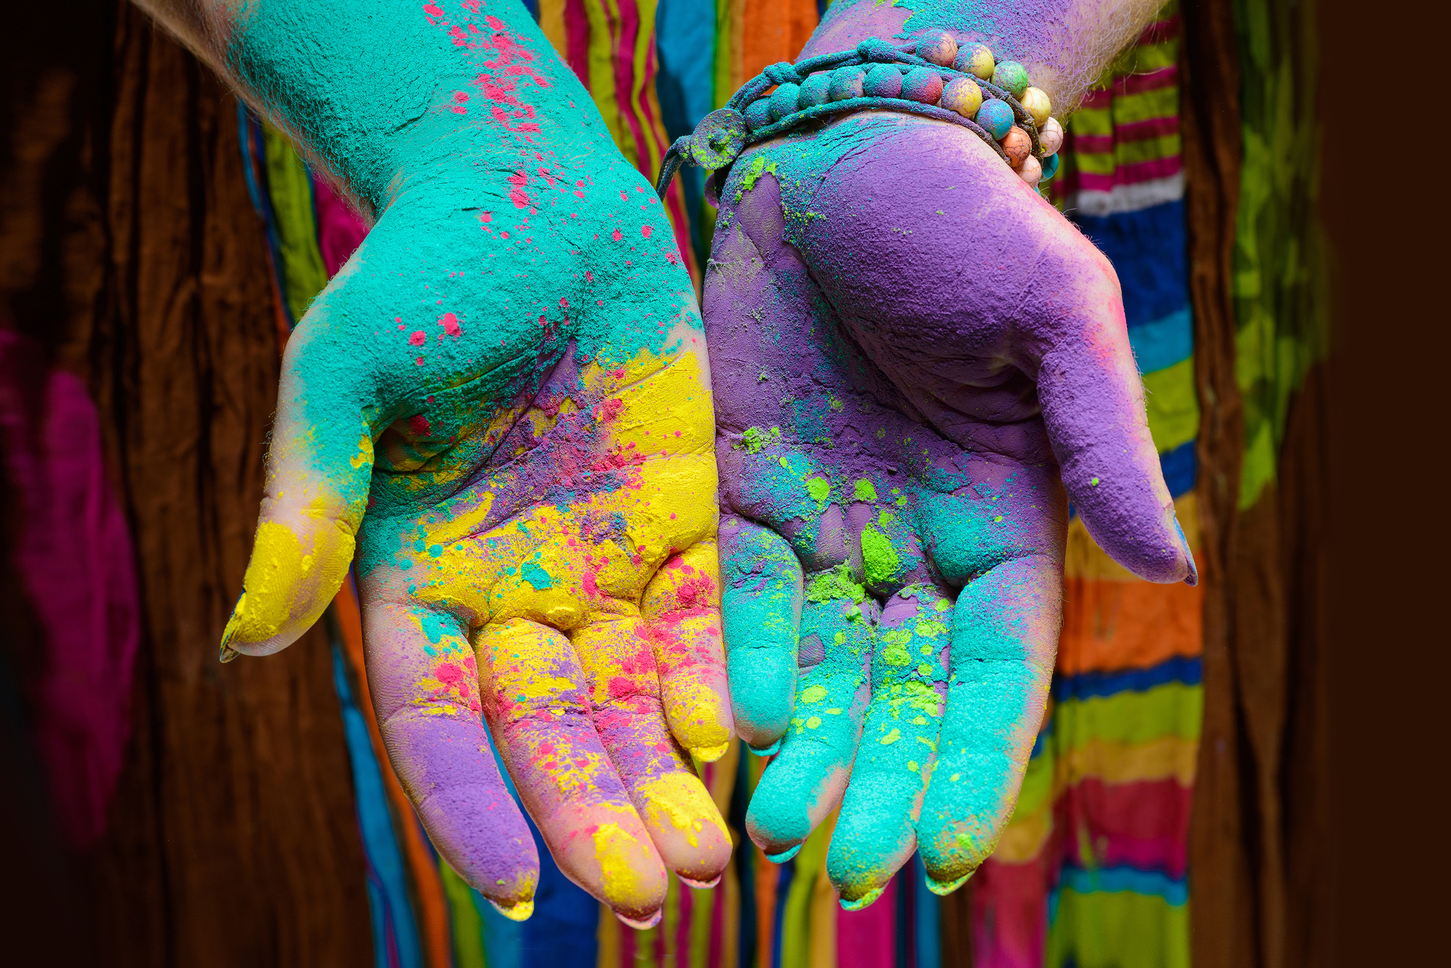
THANK YOU

